Slide 1

Group 6 Project Patrick Landis & Brian Sizemore

Slide 2
Problem Statement

Slide 3
How to raise the most $?
Kickstarter is a great resource to raise capitol for a new or growing business.
With approximately a 64% failure rate, it’s difficult for business owners to know how much money they can raise using crowdfunding.
If they had a tool/model to help them estimate their returns, they could more effectively market and maximize their Kickstarter efforts.
We would like to know how we can raise the maximum amount.
Can we predict, based on the dataset, how much money a particular campaign should or could make based on the predictors?

Slide 4
Data

Slide 5
List of Variables Transformations and Pre-Processing
Id
Currency
Top.Category
Updates
Comments
Rewards
Goal
Pledged
Backers
Duration.in.Days
Facebook.Connected
Facebook.Friends
Facebook.Shares
Has.Video
Projects.Created
Projects.Backed
X..Videos
X..Images
X..Words..Description.
X..Words..Risks.and.Challenges.
X..FAQs
D.Word1
D.Word2
D.Word3
D.Word4
D.Word5
D.WordCount1
D.WordCount2
D.WordCount3
D.WordCount4
D.WordCount5
D.Anger
D.Anticipation
D.Disgust
D.Fear
D.Sadness
D.Surprise
D.Trust
D.Positive
D.Negative
D.syuzhet.score
D.Joy
D.syuzhet.sum
D.syuzhet.mean
R.Word1
R.Word2
R.Word3
R.Word4
R.Word5
R.WordCount1
R.WordCount2
R.WordCount3
R.WordCount4
R.WordCount5
R.Anger
R.Anticipation
R.Disgust
R.Fear
R.Sadness
R.Surprise
R.Trust
R.Positive
R.Negative
R.Joy
R.syuzhet.score
R.syuzhet.sum
R.syuzhet.mean

Slide 6
Quick and Dirty Text Analysis
docs.d = Corpus(VectorSource(i))
docs.d = tm_map(docs.d, content_transformer(tolower))
docs.d = tm_map(docs.d, removeNumbers)
docs.d = tm_map(docs.d, removeWords,stopwords("english"))
docs.d = tm_map(docs.d, removePunctuation)
docs.d = tm_map(docs.d, removeWords, c('\n'))
docs.d = tm_map(docs.d, stemDocument, language = "english")

Slide 7
Text Analysis
What was generated?
Aggregate counts of the Top Words (Column Names d.WordCount1, R.WordCount2, ect.)
Emotionality Scores (Anger, Joy, Disgust, Anticipation, Trust, ect.)
Positive or Negative Sentiment of the corpus/document
aggregate positivity or negativity of corpus/document
Joined back into data set

Slide 8
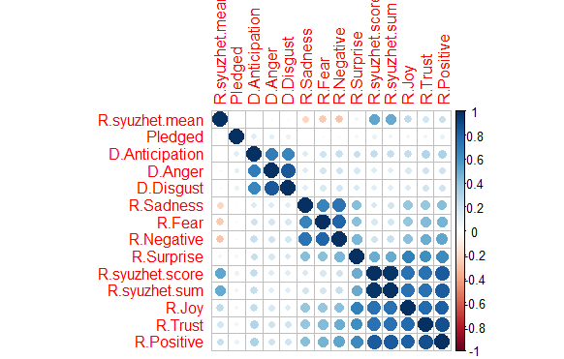
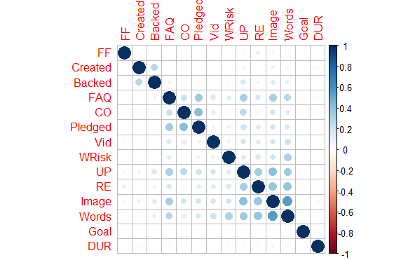
Correlations
Original Data
Sentiment Analysis Variables

Slide 9
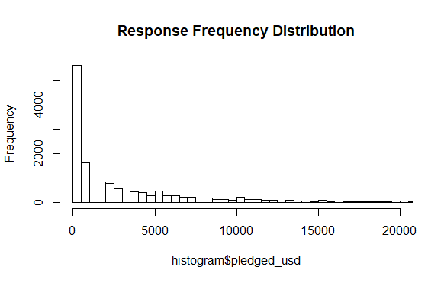
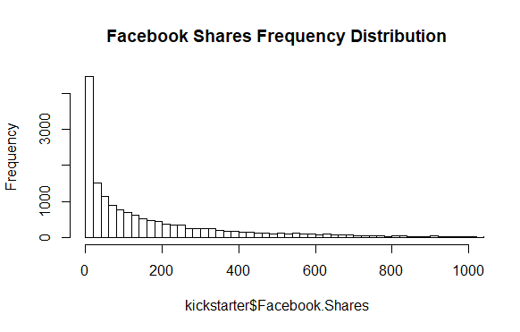
Distributions

Slide 10
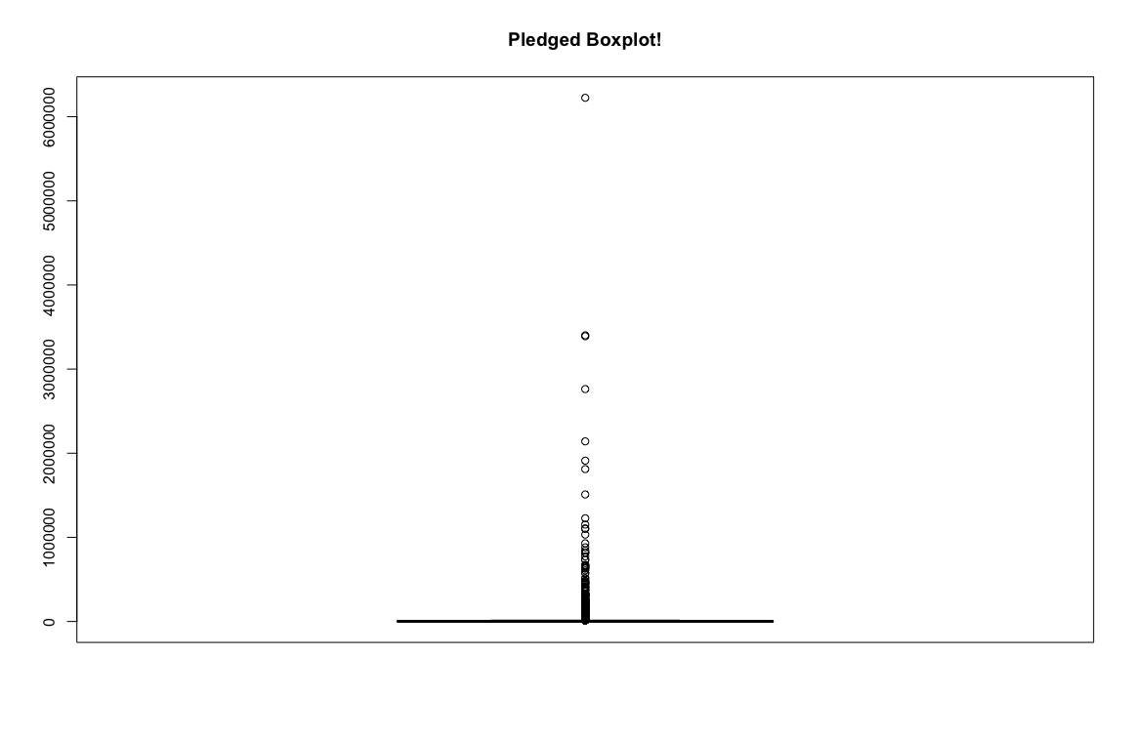
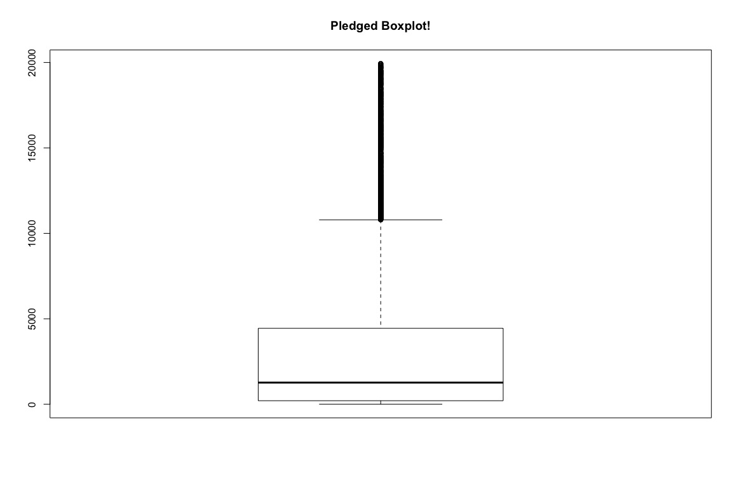
Outliers
Boxplot showing all of our data. Check out those outliers.
Boxplot zoomed into pledged amount <=$20,000

Slide 11
Models

Slide 12
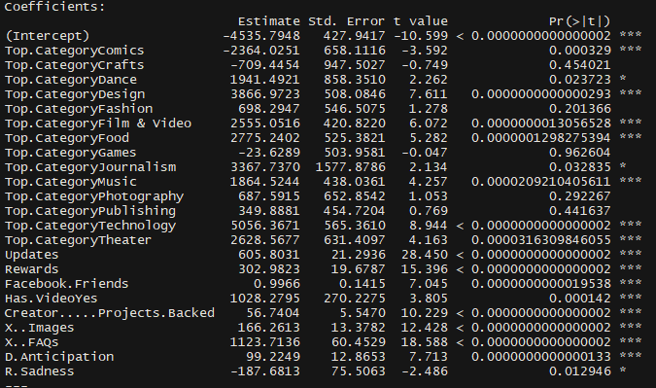
Linear Model

Slide 13
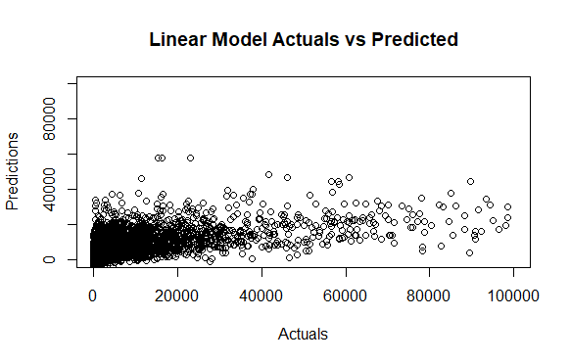
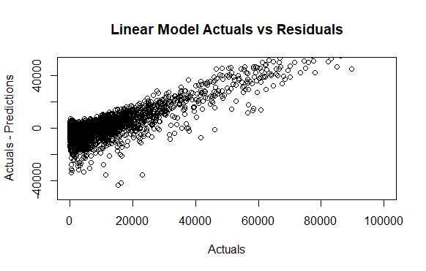
Linear Model Results
RMSE=10,363
R^2=.318

Slide 14
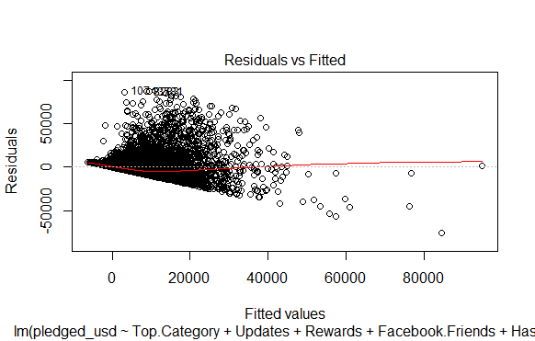
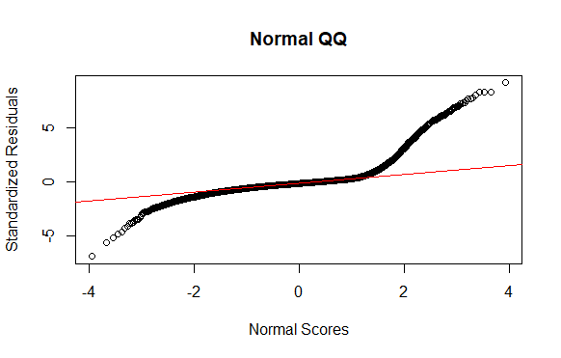
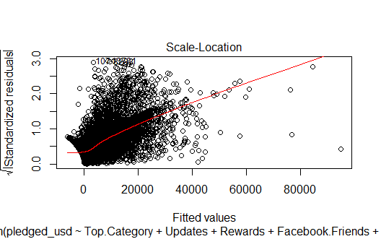
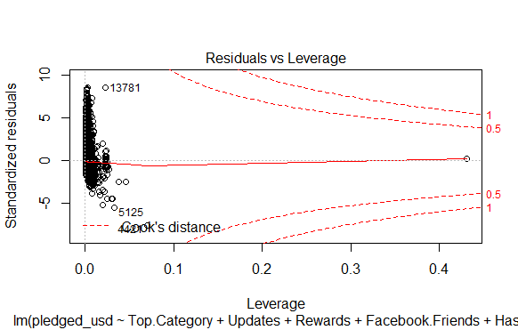
Linear Model Analysis & Conclusion

Slide 15
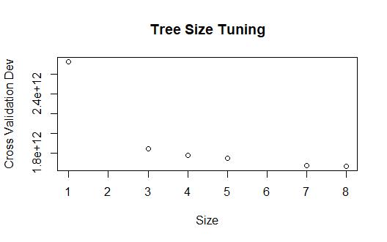
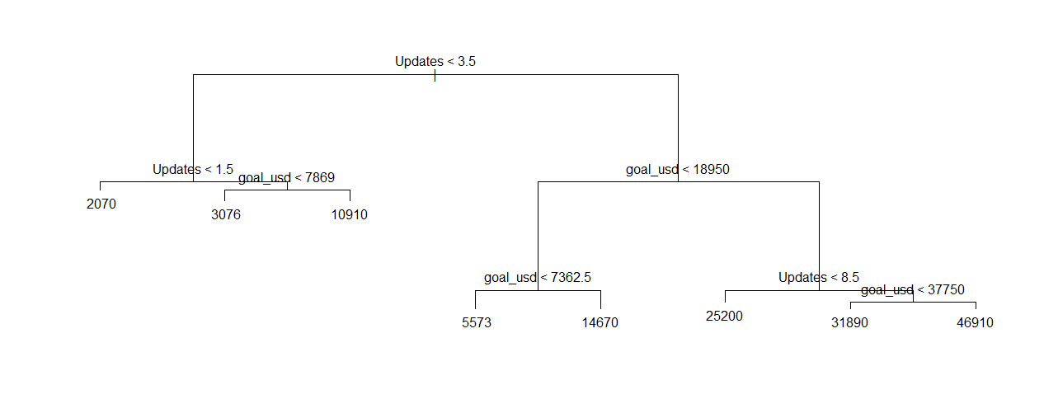
Tree Tuning

Slide 16
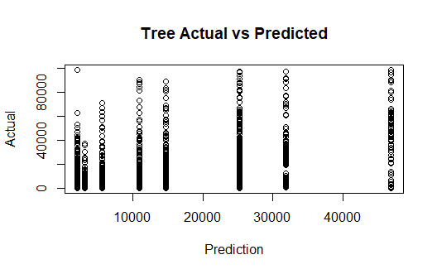
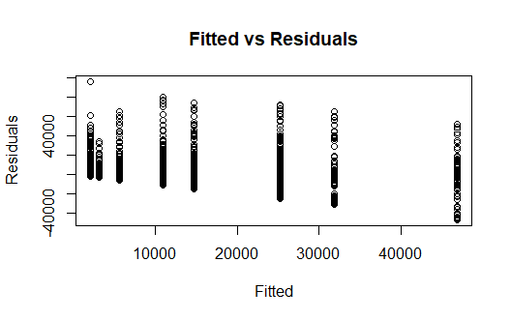
Tree Results
rmse=9,666

Slide 17
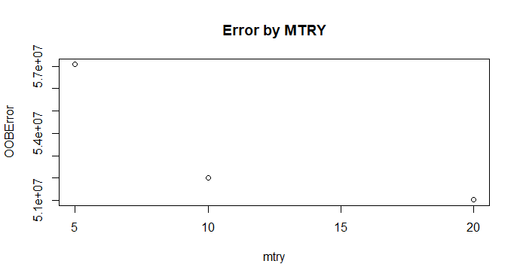
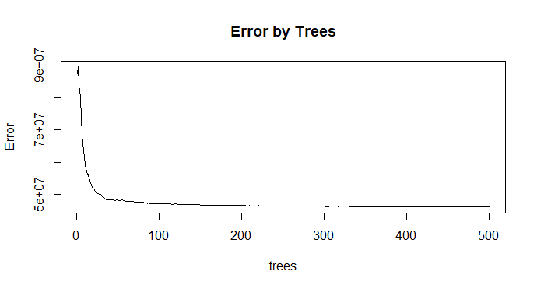
Random Forest Tuning

Slide 18
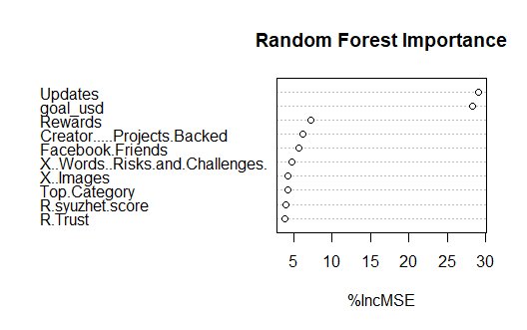
Forest Importance

Slide 19
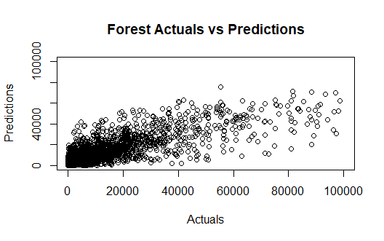
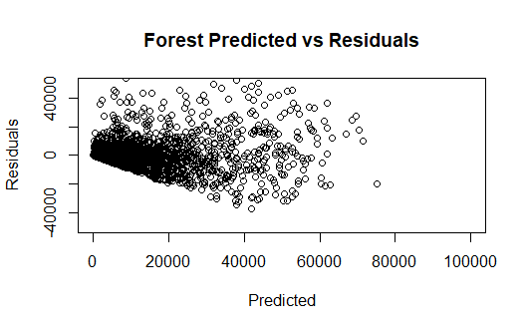
Forest Results
RMSE=6,788

Slide 20
SVM Tuning
Linear
Grid search of costs ranging between 0.75 and 1.25
Best cost of 1
Radial
Grid search of sigmas between 0.01 and 0.2 and cost between 0.75 and 1.25
Best cost of 1.25 and Sigma of 0.01
Least Squares SVM
Adaptive Grid Search using 20 steps for a max gamma of 20 and a max lambda of 0.01
Best Gamma was 4 and Best Lambda was 0.0008

Slide 21
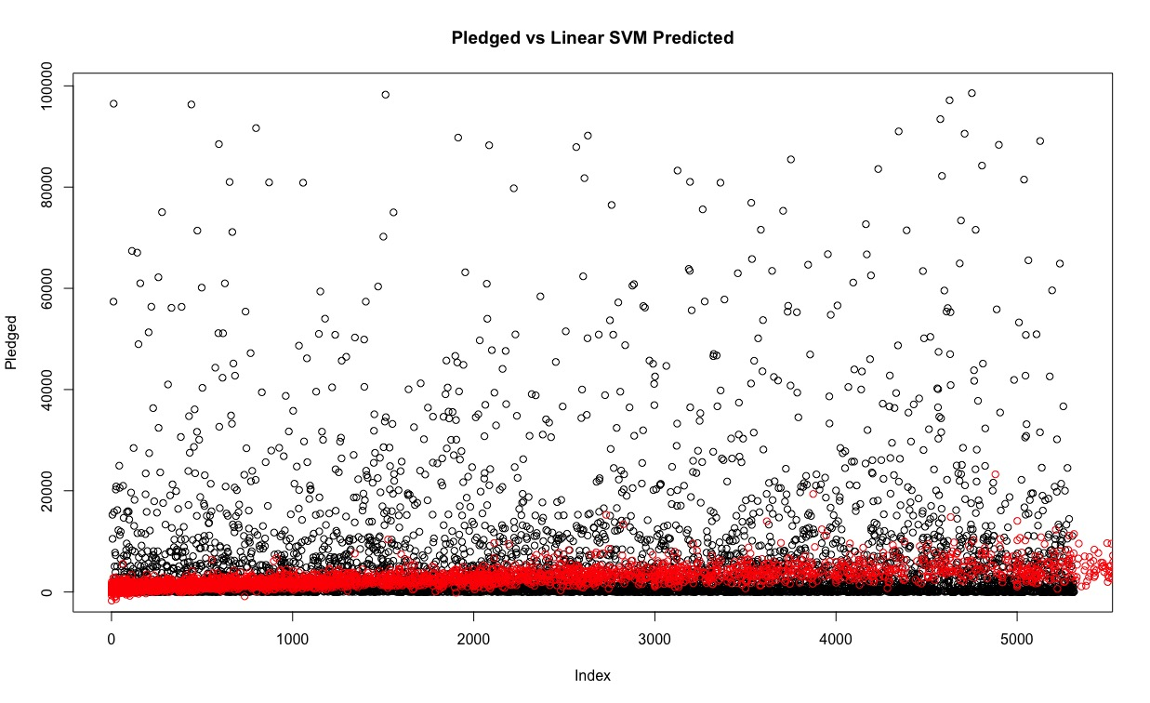
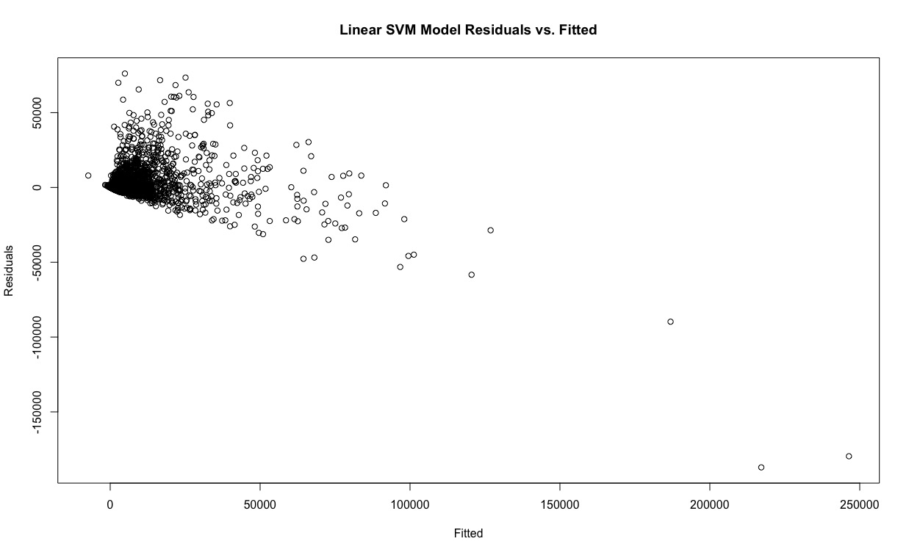
SVM – Linear Kernal
RMSE: 8568.32

Slide 22
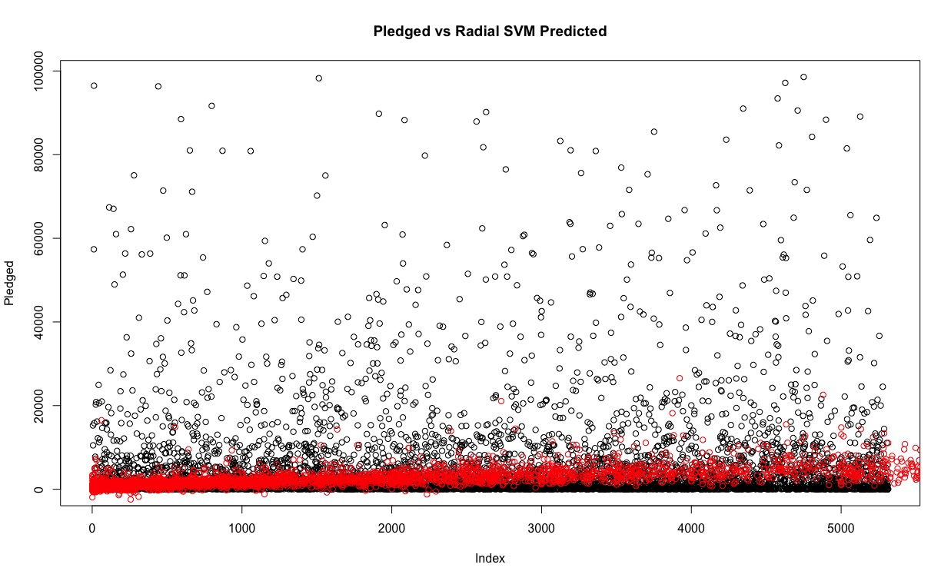
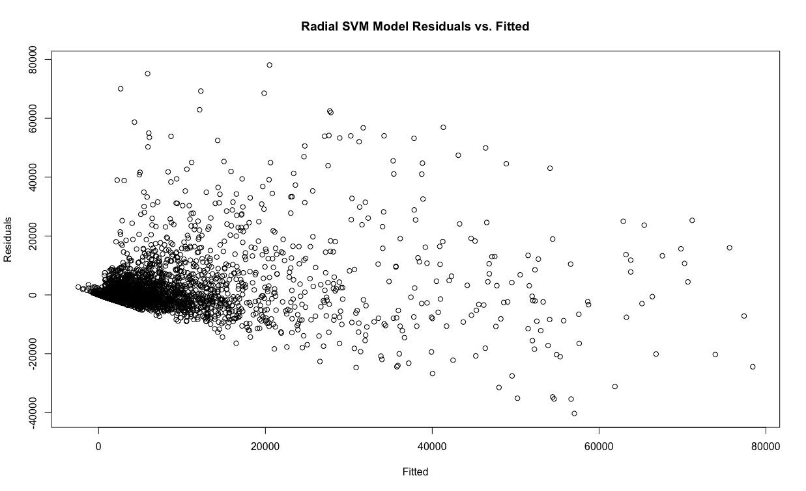
SVM – Radial
RMSE: 7435.97

Slide 23
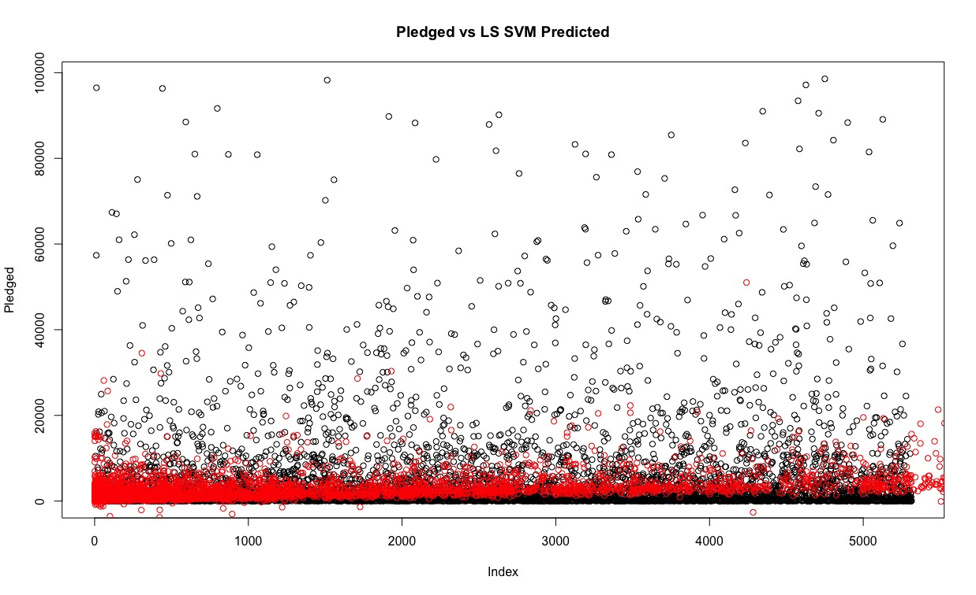
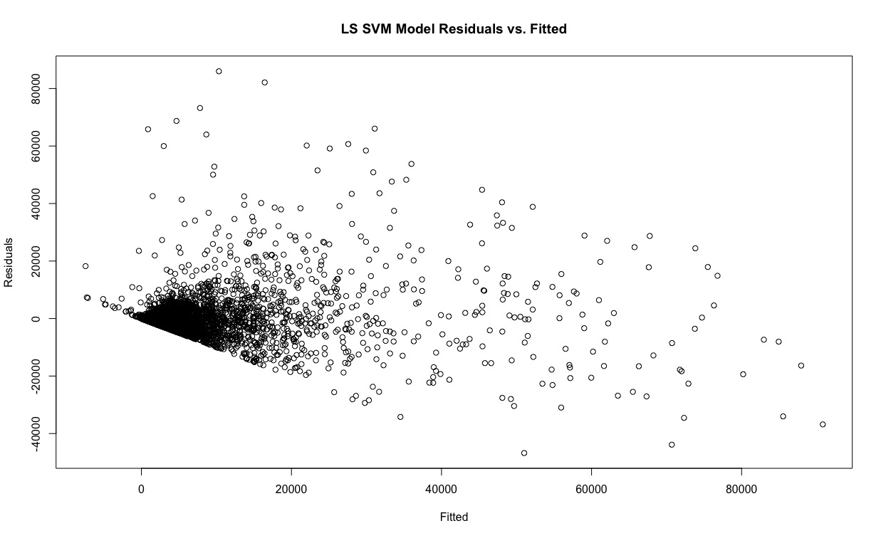
SVM - Least Squares
RMSE: 7087.35

Slide 24
Conclusion

Slide 25
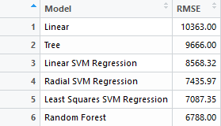
Model Performance

Slide 26
Takeaways
On the right track to create better predictions, but need more time to feature engineer and develop a model that can accurately predict the Pledged Amount
Need more data (and more current data)
Focus on smaller campaign range
trade offs between computational effort of the model, interpretability, and relatively marginal decreases in RMSE
SVM and Random Forest took quite a while to compute depending on the kernel, libraries, solvers, or methods used.

Slide 27
Questions

